Slide 1

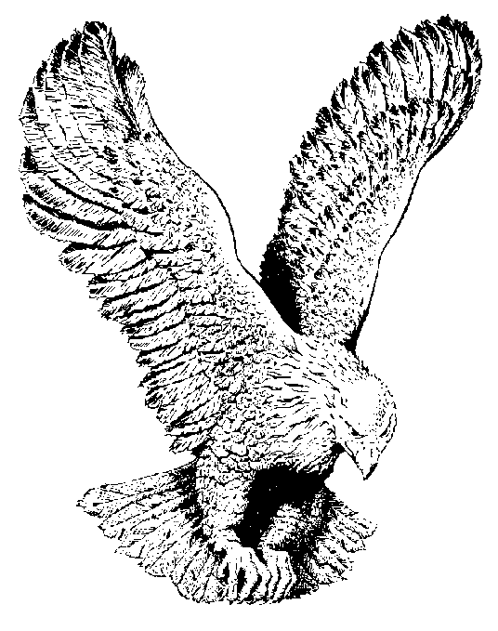
12
WEAR A CROWN
Am I a soldier of the cross,
A follower of the Lamb,
And shall I fear to own His cause,
Or blush to speak His Name?

Slide 2
CHORUS
And when the battle’s over,
we shall wear a crown!
Yes, we shall wear a crown!
Yes we shall wear a crown
And when the battle's over,
we shall wear a crown
In the new Jerusalem.
wear a crown, wear a crown,
Wear a bright and shining crown,
And when the battle’s over,
we shall wear a crown!
In the new Jerusalem.

Slide 3
Must I be carried to the skies
On flow’ry beds of ease,
While others fought to win the prize,
And sailed through bloody seas?

Slide 4
Are there no foes for me to face?
Must I not stem the flood?
Is this vile world a friend to grace
To help me on to God?
.

Slide 5
Sure I must fight if I would reign,
Increase my courage, Lord;
I’ll bear the toil, endure the pain,
Supported by Thy Word

